Slide 1

Full Stack lll - Lecture 6.1
Intro to Mongoose

Slide 2
Topics
Mongoose
Schema and Model
CRUD Operations
Queries

Slide 3
Mongoose

Slide 4


Slide 5
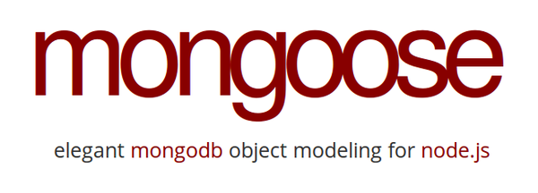

Mongoose
Alternative middleware to MongoDB Driver
Mongoose is an object modeling package for Node that essentially works like an ODM (Object Document Mapper)
Mongoose allows us to have access to the MongoDB commands for CRUD simply and easily.
https://mongoosejs.com/

Slide 6
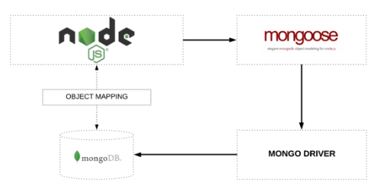
Mongoose cont..
The Mongoose document is modeled directly from the MongoDB document, thus not an ORM
Mongoose provides some features that MongoDB does not:
Validation
Defaults
Query builder
Pseduo-joins
Life-cycle management
Notes:
What is an ORM??

Slide 7


Using Mongoose
Install it via npm
Require the package in our project
Connect to the MongoDB

Slide 8
Schema & Model

Slide 9
Video - Mongoose Intro
Notes:
https://youtu.be/swWRUvluSkE

Slide 10
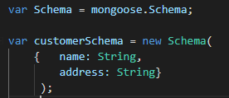
Defining Mongoose Schemas & Models
Everything in Mongoose starts with a Schema. Each schema maps to a MongoDB collection and defines the shape of the documents within that collection.
Creating a model from our schema definition

Slide 11
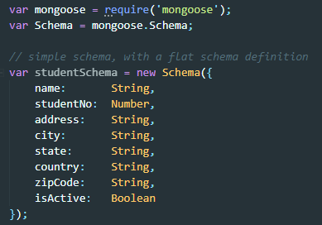

Mongoose Schema
While MongoDB is schema-less, SQL defines a schema via the table definition.
A Mongoose 'schema' is a document data structure (or shape of the document) that is enforced via the application layer.
Allowed Mongoose Data Types
String
Number
Date
Buffer
Boolean
Mixed
ObjectId
Array

Slide 12
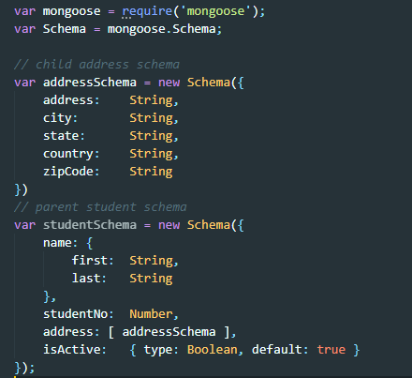
More Complex Schema
Separate out nested objects into their own schemas ie. address schema for clarity
Objects can be used as the data types and the default values can be set ie. isActive defaults = true
We can have many levels of schema nesting, ie. addressSchema could have another schema countrySchema

Slide 13
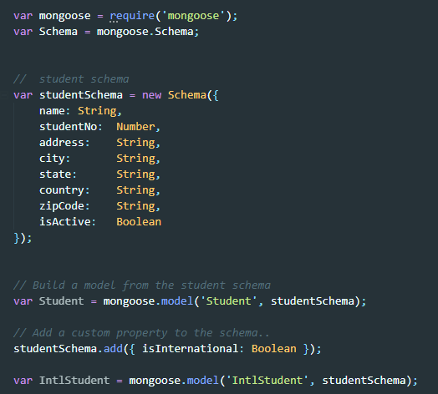
Mongoose Model
A model is a wrapper on the schema, provide CRUD interface
Models are higher-order constructor that take a schema and create an instance of a document equivalent to records in a relational database
To create a Model, pass in the model name and the document schema to ctor
More models can be built based on the schema definitions
Properties can be appended to the schema to create a new schema

Slide 14
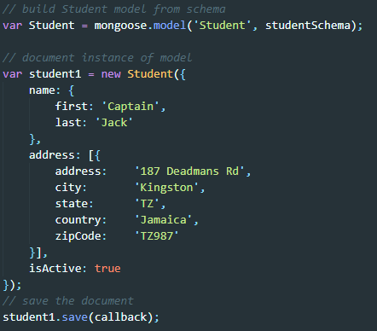
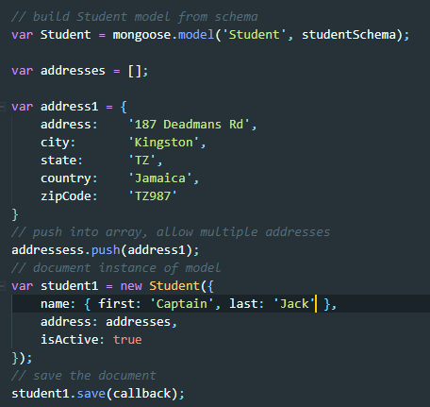
Mongoose Document & Sub Documents
A document is just an instance of our model. We can have multiple documents per model. Also, multiple sub documents per document.

Slide 15
Video - Schema Design
Notes:
https://youtu.be/gFnRo29MxtY

